Slide 1
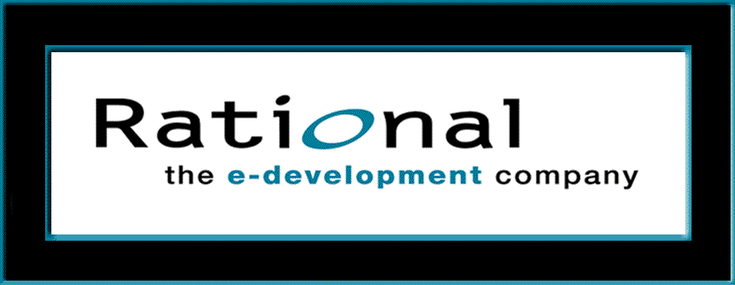
Requirements Management
with Use Cases
Module 6: Manage Scope

Slide 2
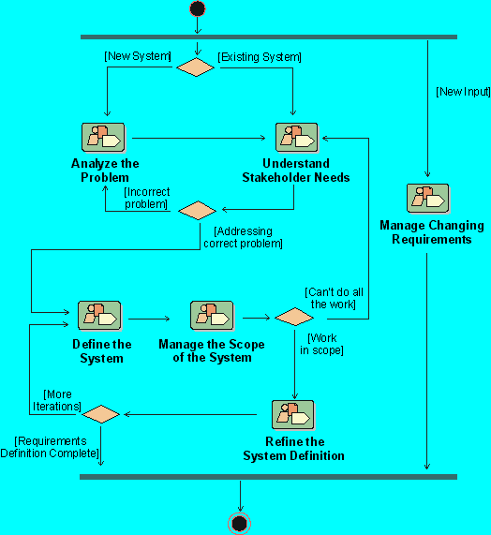
Where Are We in The Requirements Workflow?
Notes:
Where does Manage the Scope of the System workflow detail fit in our development process?
The “Managing Scope” Workflow Detail in the Rational Unified Process is performed after the system is defined, but before refining the definition. We do not want to waste time refining parts of the system that are outside the scope of the current version of the system.
Where is this done in your own software development process?
If presenting this course on-site at a company not using RUP, discuss the activities they use to accomplish this objective.

Slide 3
Manage Scope: Module Objectives
Define attributes and traceabilities to maintain
Define input for setting a baseline
Decide on a baseline set of features
Prioritize use cases among the iterations

Slide 4
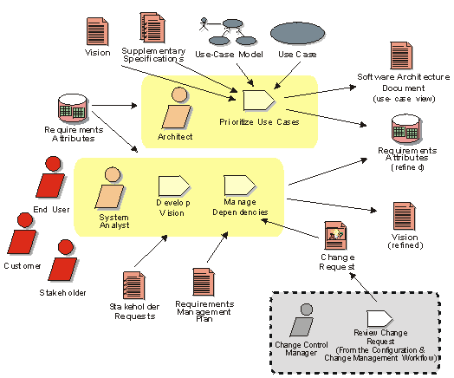
Manage Scope: Activities and Artifacts
Notes:
In RUP, the purpose of this workflow detail is to:
Define input to the selection of requirements that are to be included in the current iteration
Define the set of features and use cases (or scenarios) that represent some significant, central functionality
Define which attributes and traceabilities to maintain
Although project scope should be managed continuously, it is easier to make informed decisions after identifying most actors, use cases, and supplementary specifications. The system analyst applies customer priority, effort, cost, risk values, and other requirements attributes to more accurately rank the development priorities. This enables the architect to identify the architecturally significant use cases.
The Iteration Plan is developed in parallel by project and development management. The Iteration Plan defines the number and frequency of iterations planned for the release.
The scope of the project defined in Managing Scope will have a significant impact on the Iteration Plan because the highest risk elements within scope will be planned for early iterations. Other important outputs from Managing Scope include the initial iteration of the Software Architecture Document and a revised Vision that reflects system analysts’ and key stakeholders’ better understanding of system functionality and project resources.

Slide 5
Manage Scope: Focus on Priorities
Problem
Problem Space
Needs
Solution Space
User /
Customer
Features
Development
Team
Traceability
The Product To Be Built
Software
Requirements
Test Procedures
Design
User Docs
Notes:
Scope management is maintaining the “healthy tension” between what the customer wants (maximum features) and what development believes they can deliver in a fixed time frame. It is essential for the developer to get the agreement of the customer on the baseline set of features to develop in the system to be built.
A good way to achieve the balance between customer desires and developer resources is by using iterative development and providing incremental “slices of the pie.” That way, the priorities can be reassessed at the end of each iteration.
Point to the paper where you have posted this pyramid. Explain that in this module we are focusing on Prioritizing the scope of the system.
There are two fly-ins, which you activate with a mouse-click for each of them.
The ideal time to decide on what is in the baseline set of features we will actually develop is after the system is defined (Module 5) and before we have put a lot of time into refining the details (Module 7).
Mention the “healthy tension” between what he customer wants and what the developer can supply in the time available.

Slide 6
Defining System Scope
How Much Work
Can We Do?
Resources
Time
Notes:
In Module 6, we will focus on what we can do realistically to take the fixed amount of resources and choose the best value to produce for our customers. Of course there’s always overtime, but we also want to avoid eventual burnout and be in this for the long haul -- pacing ourselves for a marathon, rather than a sprint.
Refer back to our discussion of this slide (and the following slide) in Module 0, About This Course.
See Student Notes for points to emphasize.

Slide 7
To Meet the Customer’s Real Needs?
Feature 1: The system...
Feature 2: The system...
Feature 3: The system...
Feature 4: The system...
Feature 5: The system...
Feature 6: The system …
Feature 7: The system...
...
Feature n: The system...
How do we know what the needs are?
How do we determine priority?
Where do we set the baseline?
Time
Project
Start Date
Target
Release
Date
Notes:
How do we reach agreement on what features should be included in our project? Where would we set our baseline commitment for delivery? By “baseline” we mean the set of features that constitutes the agreed upon basis for development and that can only be changed through a formal procedure.
The key is to under-promise and over-deliver -- but not too much! We want to maintain our credibility.
What needs of our stakeholders do they represent? How should they be prioritized? What factors might influence the order in which we rank the features?
Refer back to our discussion of this slide in Module 0.

Slide 8
Using Feature Requirement Attributes
Notes:
Here are some suggestions for attributes to collect about each of our features.
Wouldn’t it be helpful if we could collect all of these attributes for each of our different types of requirements (stakeholder needs, features, use cases, detailed software requirements) and then have them available later when we need to make important decisions regarding them?

Slide 9
Links to Other Project Elements
Requirement attributes provide a link between requirements and other project elements
  Priorities, schedules, status, design elements, resources, costs, hazards
For example:
  “Status” provides current status of each requirement
  “Effort” estimates the work to do each requirement
Notes:
The attributes could also be used (and are often already collected) for other project elements.

Slide 10
Sample Requirement Attributes
Rationale
Reason for the requirement
Customer Priority
Customer’s priority for development
Status
Proposed, Approved, Incorporated,
Validated
Risk
Probability of adverse project
Impact: schedule, budget, technical
Safety/Criticality
Ability to affect user health or welfare
Responsible Party
Pull-down list
Origin
Source of requirement
Stability
Probability that the requirement will
not change
Notes:
The attributes for each type of requirement are defined in the Requirements Management Plan (see Requirements Management Plan Template in Handouts). The attributes for features may also be defined in the Vision Document, Appendix, as we saw in the previous module.
The attributes are initially defined in the activity “Develop Requirements Manage Plan, as we saw in the module about Analyzing the System. They are refined throughout the project, in the activity “Manage Dependencies.”
Here are some sample attributes.
Have the class suggest some others.
We want to maintain a list of attributes with a brief description to clarify any ambiguities.
For example, risk and stability can often be confused. Read through these two definitions here to help the class understand the difference intended by the two attributes (this will also be helpful when you run the next exercise, since these are two of the attributes that often confuse folks).

Slide 11
Management Uses for Requirement Attributes
Assigning resources
Assessing status
Calculating software metrics
Managing project risk
Estimating costs
Assuring user safety
Managing project scope
Notes:
What can we use these attributes for?
Use examples to illustrate these uses of attributes. For example, by adding up the estimated costs of each requirement, you get an estimated total cost for developing the entire system.
Ask: How would you use requirement attributes to assess project status?
Of course, you cannot use requirement attributes for estimating total cost unless you have recorded cost for each requirement. You need to have good data before you can use it.
We’ll next focus on using attributes for managing project scope.

Slide 12
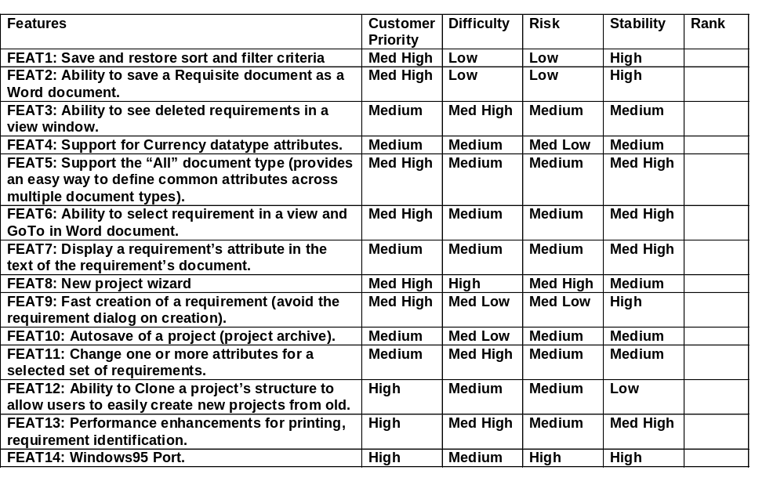
Exercise: Using Attributes to Prioritize
Handout
Worksheet at end of module
Notes:
The purpose of this exercise is to explore how we might use attributes of requirements (in this case, features) to make a decision about the relative importance of each when determining what to cut when managing scope.
Each group should come up with a ranking showing the order in which the tasks should be considered for inclusion in the release of the product, using the following input (attributes):
The text of the requirement
Priority (input from the customer)
Difficulty (input from development)
Risk (to the project)
Stability (of the requirement)
For this exercise, use the worksheet provided at the end of this module.
RECOMMENDED:
Small-group exercise followed by whole-class discussion.
Estimated time:
20-30 minutes for group work.
15-20 minutes for class discussion.
Give them the following scenario to start the exercise:
They are playing the role of the V.P. of Engineering for a product.
The Development manager (the instructor) has just told them that they only have the resources to accomplish 2/3 of the work shown on this feature list.
They have to catch a cab to the airport in 20 minutes [so they have no time to go back to talk with the customer]. What requirements would they recommend for the baseline scope?
Each group should rank the tasks using the following input (attributes):
Text of the requirement
Priority (input from the customer)
Difficulty (input from development)
Risk (to the project),
Stability (of the requirement)
Point out the worksheet, which is located at the end of this module.
Each group lists its ranking of the features on the easel. For ease of comparison, list ALL the requirements (not just 2/3 of them); and list them in rank order (which to do first, second, etc.) rather in requirement order as on the form. Discuss reasoning. Some questions to discuss:
What were the results? What method did you use to get the results?
What are the advantages of using a formula?
What different assumptions or methods led to the different results? What other information would you have liked to help you make your decisions?
How do you set scope now in your own organization?

Slide 13
How to Prioritize Use Cases
What use cases should be implemented?
  The use cases linked to features in the baseline scope
In what sequence should use cases be done?
  1. Select uses cases for architectural iterations
    Represent significant, central functionality
    Have a substantial architectural coverage (exercise many architectural elements)
    Stress a specific, delicate point of the architecture
  2. Prioritize use cases/scenarios for future iterations
Notes:
In the method we are discussing, we prioritize FEATURES and decide which features are in the baseline for the current version of our product.
What use cases are in the baseline scope? The use cases in the scope are those linked to the features in the scope. For example, if a feature in the baseline is “The ATM will allow the customer to transfer funds,” then the Transfer Funds Use Case is in the scope.
After we know which use cases are to be implemented, in what order should we design and implement them? In RUP, assigning use cases to iterations is called “prioritizing” them. Note that this is a different meaning for “prioritizing” than setting a baseline.
The first few iterations in a project are sometimes called the architectural iterations because these iterations are used to test out the architecture. So, use case(s) of architectural significance are done first.
Then, we decide on the approximate sequence for future iterations. But, during the assessment at the end of every iteration, we may need to revise the order in which use cases are assigned to future iterations.
The System Architect is responsible for the technical contents and the order of successive iterations. The System Architect selects use cases to be analyzed and designed. This technical proposal is completed and refined by the various development teams - based on personnel availability, customer requirements in terms of deliverables, availability of tools, and the needs of other projects.
First we decide on the scope. In the method we have been discussing, we decide on the scope of the FEATURES that are in the baseline. That is, we decide what major functionality will be in our product.
Based on the features in the scope, we decide on what use cases will be in the scope of this version of the system. Then we order, or “prioritize” the use cases across the iterations.

Slide 14
The Use-Case View
Use-Case View is in the
Software Architecture Document
The Use-Case Model
Top-Level Package
Shows an architecturally
significant subset of
U
Use-Case Packages
The Architectural
Use-Case
View
Actors
Use Cases
Notes:
The Analysis, Design, and Implementation workflows subsequent to requirements are centered on the notion of an architecture. The production and validation of that architecture is the main focus of the early iterations, especially during the Elaboration phase. Architecture is represented by architectural views
To provide a basis for planning the technical contents of iterations, an architectural view called the Use-Case View is selected during the Requirements workflow. The use-case view of the system is the set of use cases that are architecturally significant. The System Architect is responsible for deciding which use cases are in the Use-Case View.
Selection of use cases for the use-case view is driven by: the ranking of the scenario (critical, important, ancillary); the risks to be mitigated (performance, availability of a product, and suitability of a component); the completion of the coverage of the architecture (making sure that at the end of the Elaboration phase, every piece of software to be developed has found a home in the Implementation View); and other tactical objectives or constraints: demo to end-user, and so on.
There are four additional views: the Logical View, Process View, Deployment View, and Implementation View. These views are handled in the Analysis & Design and Implementation workflows.
The architectural views are documented in a Software Architecture Document. You may add different views, such as a security view, to convey other specific aspects of the software architecture.
The Use-Case View is the set of use cases that are architecturally significant. In a small system, the Use-Case View may contain all of the use cases. But in most systems, the Use-Case View is a small subset of use cases.
The Use-Case View is important because we want the architecture we develop in the first few iterations robust enough to support the parts of the system developed in later iterations.

Slide 15
Exercise: Prioritizing Use Cases
Iteration 1
Look at the use cases in your class project
What use case would you choose in the first iteration? Why?
What else should you consider?
Handout
UC5
Notes:
The Use-Case View, within the Architecture document, includes the allocation of use cases to the planned iterations of the lifecycle.
The purpose of this exercise is to start to get a feel for what the architect may be looking for in determining those use cases that would test the key functionality of the architecture.
RECOMMENDED:
Whole-class discussion.
Estimated time:
For class discussion of the exercise: 5-10 minutes
For discussion of Sample Iteration Plan (UC5): about 5 minutes.
Explain the objective of the exercise. The objective is to decide on which use cases or parts of a use case (scenarios) to do in the first architectural iteration, at the beginning of the Elaboration phase.
For the exercise, we will look at the class project. Remind the students about what use cases are in the class project.
Ask the students: “Which use case or part of a use case would they choose for the first architectural iteration?” Then, lead a class discussion. Allow the students to explain their decisions and their reasoning. Also point back to the criteria for selecting use cases in the Use-Case View (slide 6-13) and point back to attributes that might help in prioritizing use cases for allocation to iterations (slide 6-10).
AFTER discussing this exercise, you should have the class look at the iteration plan in (ATM) handout UC5. Allow 5 minutes for a discussion of Handout UC5, but don’t get bogged down.

Slide 16
How to Manage Scope
Gain control of requirements input
Gain control of requirements output
Gain control of the requirements process
Sources
of Requirements
Requirements
Process
Agreed-upon
Requirements
Weinberg, ‘95
Notes:
Why is scope management so hard? It is because the requirements change and other environmental factors (such as resources, budget, and so on) change around us.
So, we need to have an on-going process that will assure us that the amount of work we are planning to do stays do-able and under control.

Slide 17
Gain Control of the Requirements Input
Official Sources
  Requirements specifications
  Customer requests
  Marketing department
  Bug reports and enhancement requests
  Competitive analysis
Unofficial Sources - (Leakage)
  Enhancements mentioned by distributors at a sales convention
  Direct customer requests to programming
  Inserted by programmers with “careful consideration” of what’s good for the customer
  Mistakes that are made and shipped and must be supported
  Hardware features that didn’t get in or don’t work
  Knee-jerk change of scope reaction to competitors
  Programmer’s “Easter Eggs”
Weinberg, ‘95
Notes:
Note that the actual sources (people-wise) are the same for both columns, such as customers, marketing, and developers.
What is the difference between the two columns? Adherence to an agreed-upon process, rather than ad hoc, uncontrolled input.

Slide 18
What to Do About Unofficial Sources?
Recognize that requirements come from many sources and know what those sources are
Accept that these interests are legitimate
Create an explicit negotiation process
Develop a process to guarantee that all requirements come through a single channel
  Benefits of “batching” requests
  Use of a CCB (Configuration Control Board)
  Product manager
Weinberg, ‘95

Slide 19
Gain Control of the Requirements Output
Document the requirements
  Write them down!
  Collect them in a central repository
  Make them accessible and visible to all stakeholders
  Keep them reasonably stable
  Control the changes (avoid “scope creep”)
Use requirement attributes and traceability
  Gather useful information from the right people
  Attributes/traces in a repository along with requirements
Weinberg, ‘95
Notes:
The key is to keep the requirements visible (write down what is agreed on) and accessible to all team members.

Slide 20
Gain Control of the Requirements Process
Process support
  Iterative development
  Requirement reviews
  Change management
Resource support
  People
    Staffing
    Training
  Tools
    Repository
    Network
    E-mail
Weinberg, ‘95
Notes:
We can get from the sources to our controllable requirements by dedicating to a workable process to which “everyone” should adhere. But we need to provide support for requirements management, including both process and resource support.

Slide 21
All Requests Go Through a Single Channel
Change requests come from many sources throughout each iteration of the product lifecycle
Customer and
End-User inputs
New Feature
Req
Single Channel
for Approval
Marketing
New
Requirement
Design
Approved
Decision
Process
(CCB)
Coders inputs
Testers inputs
Bug
Code
Change
Request (CR)
Test
Help Desk
End-User inputs
Maint
Notes:
As requests come in during our lifecycle, we need to intercept them and make sure that they pass through a single approval channel.
The single channel of approval may be one person (like a project manager), or perhaps a group of representatives (for example: a CCB, Change -- or Configuration -- Control Board). The CCB should have representatives from each of the relevant groups.

Slide 22

The Product Champion
Helps manage project scope
  Owns the product vision
  Advocates for the product
  Negotiates with management, users, and developers
  Defends against feature creep
  Maintains a “healthy tension” between what the customer desires and what the development team believes it can deliver in the release timeframe
  Represents the official
  channel between the customer and the development team
Notes:
The product champion is a very important, yet often intangible, aspect of having a successful project.
Usually this is not a job title, but a role played by a key individual.
Would you want to have a product champion on the development side or the customer side?
At what level in your company would this person need to be at in order to be effective?
This is a good time to have people in the class share stories of projects they have been involved with, in which a “product champion” (or the lack of one) was key in making or breaking a project.
Usually this is not a job title, but a role played by a key individual.
May want to have one on both the development side and the customer side.
At what level in you company would this person be to be effective? (key is that they must have enough authority to make things happen)

Slide 23

Managing Expectations
Why manage expectations?
  People perceive things differently
  People are not logical
  Analysts are people too
  Things happen
A new car!
A new car!
Gause & Weinberg, 1989
Notes:
One of the keys to having a happy customer at delivery time is to manage their expectations of what they are to receive.
This is key on both the customer (especially) and the developer side.

Slide 24
How to Manage Expectations
Understand customer expectations
Limit the expectations as appropriate
Include the source of the limitation
Under-promise and over-deliver
Then, keep the possibilities open
Notes:
Communication is very important. No surprises!

Slide 25
Improve Your Negotiation Skills
Key to any successful, multi-party program
A normal, professional activity
Tips
  Start high, but not unreasonable
  Separate the people from the problem
  Focus on interests, not positions
  Understand your BATNA
  (Best Alternative To a Negotiated Arrangement)
  Invent options for mutual gain
  Use diplomacy
Improve your skills at soonest opportunity!
Fisher, Ury, Getting to Yes, 1991
Notes:
The information on this slide is from the Fisher & Ury book: Getting to Yes. These guys worked with the Harvard Negotiation Project, which did studies of high-level (mostly diplomatic) negotiations and what made them successful. For example, they studied the agreements between the Israelis and the different Arab factions.
Re: BATNA (Best Alternative To a Negotiated Agreement) -- this encourages you to also look at the consequences of *not* getting an agreement, How important is that to you? What if the customer cancels the project? This gives you a “bottom line” from which to work.
Key is focusing on the interests of all involved and trying to come up with creative options that would satisfy both sides.
This information is from Getting to Yes, by Fisher and Ury. Fisher and Ury worked with the Harvard Negotiation Project, who studied high-level (mostly diplomatic) negotiations and evaluated what made them successful. One example in the book describes the negotiations for agreement between the Israelis and the different Arab factions.
The concept of BATNA (Best Alternative To a Negotiated Agreement) encourages you to also look at the consequences of “not” getting an agreement. How important is that to you? What if the customer cancels the project? This gives you a “bottom line” from which to work.
The key is to focus on the interests of all involved and attempt to come up with creative options that would satisfy both sides.

Slide 26
Review: Manage the Scope of the System
1. How are attributes useful in managing scope? What else can they be used for?
2. What three steps are important in managing scope?
3. What are some official sources of your product’s requirements?
  What are some unofficial sources?
  How can these be controlled?
4. Why is it important to manage expectations? How is it done?
5. What is the role of the “product champion”?
  Why is it important for your product to have one?
  Does your product have a “champion”? Who is it?
Notes:
Use these questions to monitor the students’ level of understanding and to help them review.
Tell them they can look back through the material to get the answers.
Give them time to answer. Don’t be afraid to stand quietly while they look up the answer.
Remind the students that they can get more detail on this topic by reading Team Skill 5, “Managing Scope” in Managing Software Requirements, by Dean Leffingwell and Don Widrig.

